Slide 1
WAGASCI-BabyMIND new Monte Carlo software
Pintaudi Giorgio, PhD
Yokohama National University

Slide 2
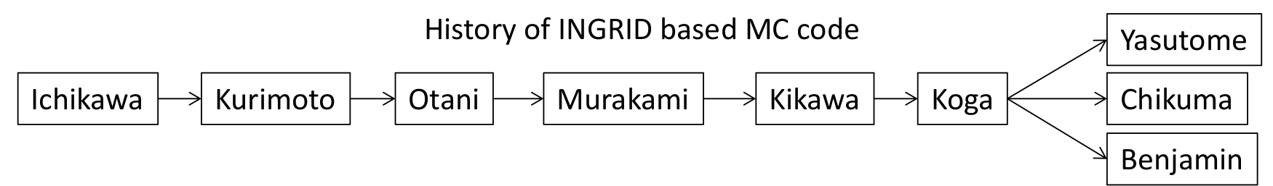
WAGASCI - BabyMIND Monte Carlo history
It was developed starting from the INGRID Monte Carlo code
There were three major problems with the previous version:
It was designed only for INGRID
Many people contributed to it without any version control
The output is taylored towards the INGRID cross-section analysis

Slide 3
Problem 1 : it was designed only for INGRID
INGRID | WAGASCI-BabyMIND
No double readout | WallMRD and BabyMIND have double readout
Only horizontal, vertical and veto scintillators | WAGASCI has grid scintillators and YASU tracker has double scintillators (left - right)
Many variables are still called ingrid_<something>
position of INGRID modules does not change very often | Position of WAGASCI detectors changed often and it is much more complex

Slide 4
Problem 2 : no version control
Many people in different period of times contributed to the code
Without a version control system, it is difficult to understand who is doing what
Some code that is not used anymore is left there to rot
Huge chunks of code are commented out for no apparent reason
Some constants are defined more than once with different values

Slide 5
Problem 3 : output designed for INGRID analysis
Many branches are useful only for INGRID analysis
Some information useful for WAGASCI-BabyMIND is missing or difficult to read
Michel electrons are not stored
Response of electronics and scintillators is fully implemented only for Proton Module
This is the only thing left to do

Slide 6
Solution 1 : new data format
HITS | TRACKS | VERTICES
can accomodate double readout | tracks can cross many subdetectors | can be not only primary vertex, but secondary vertices too
It is assumed the detectors are already calibrated | Initial and final information is recorded | Each spill can contain many events (primary vertices)
is compatible with all WAGASCI subdetectors | can record primary particles and secondary particles
More about the new data format later

Slide 7

Solution 2 : version control system
All code is hosted on WAGASCI-BabyMIND GitLab
A proper git branching model is exploited (Vincent Driessen model)
A version number is used to tag all versions (current is v0.1.0)
Everybody is getting used to git and I see a lot of improvement

Slide 8
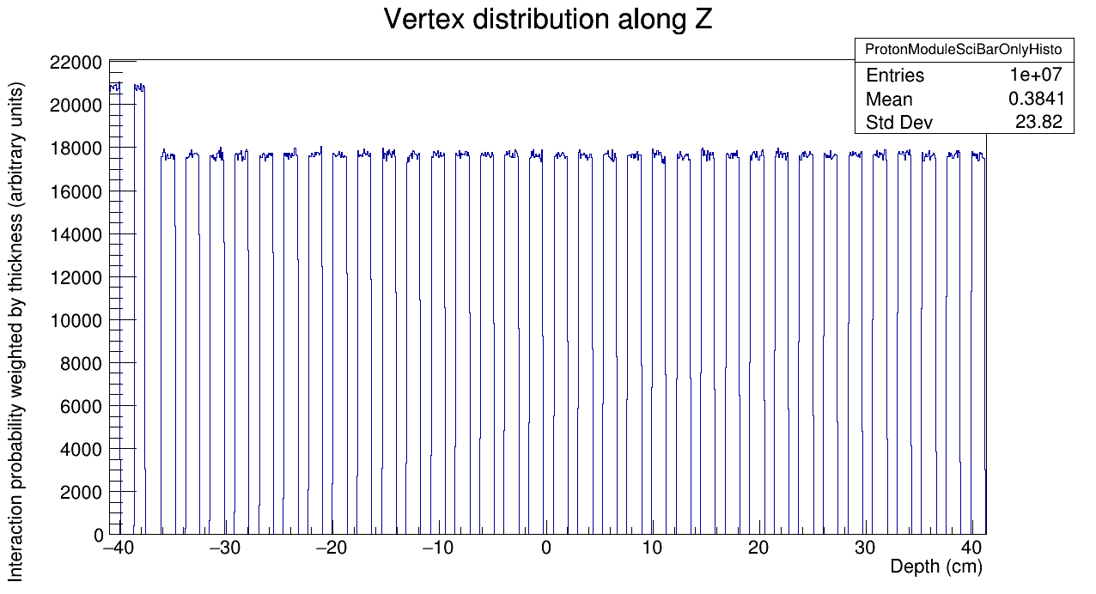
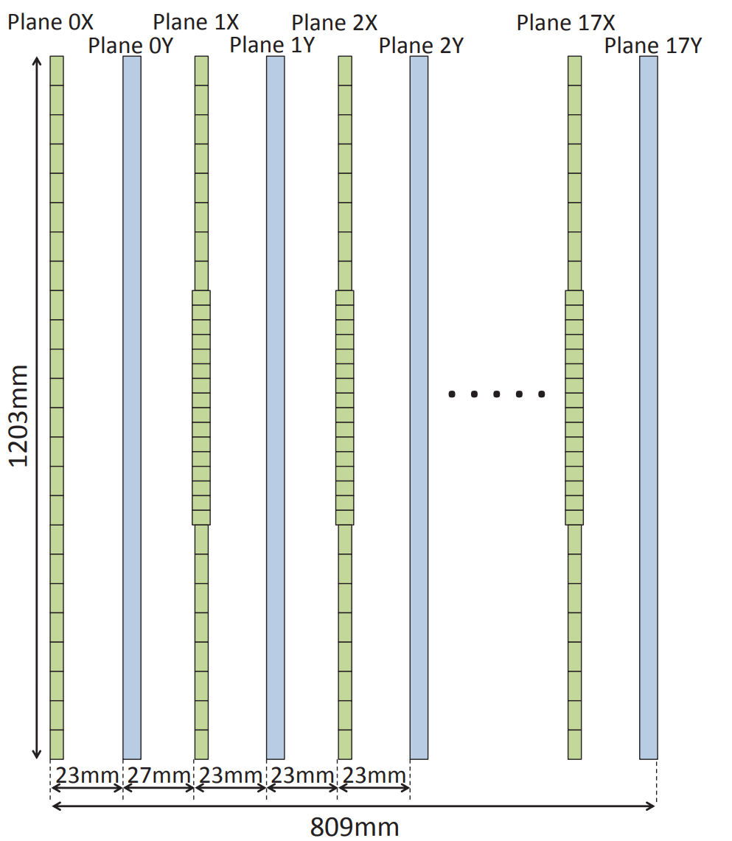
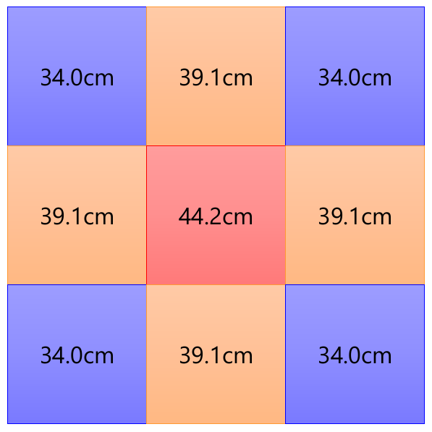
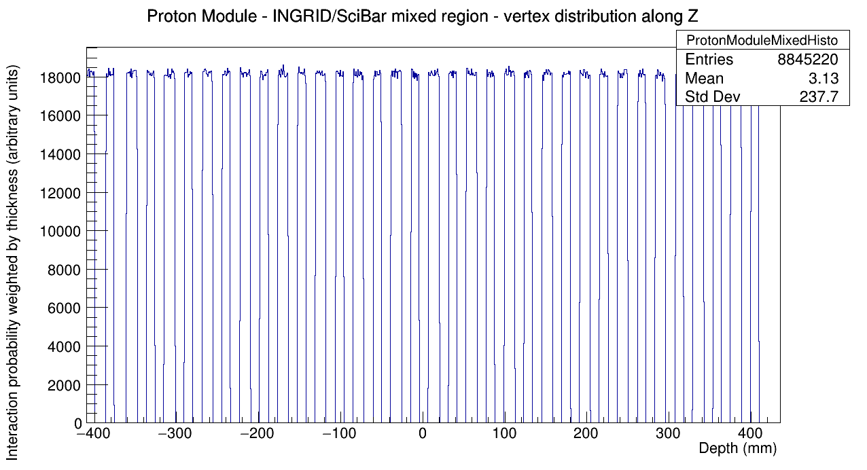
Solution 3 : WAGASCI-BabyMIND analysis
Fixed some bugs in the vertex Z position of Proton Module
Probability of vertex in the front VETO planes was higher than the other planes

Slide 9
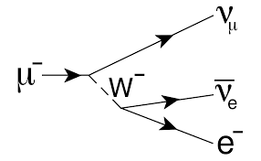

Solution 3 : WAGASCI-BabyMIND analysis
Michel electrons are found and recorded
The decay of the muon into neutrinos and Michel electron must be checked manually (Geant4 does not provide a function like “give me Michel electron”)
All decay products are looked for (muon neutrino, electron neutrino and Michel electron) and checked
The invariant mass of the decay is checked for consistency (up to 5%)
Since the invariant mass is determined from quantities which are conserved during a decay, the invariant mass calculated using the energy and momentum of the decay products of a single particle is equal to the mass of the particle that decayed. The mass of a system of particles can be calculated from the general formula:
and the relative decay for μ+

Slide 10
Solution 3 : WAGASCI-BabyMIND analysis
Response of Proton Module is fully implemented
Response of WAGASCI scintillator is implemented. Response of WAGASCI electronics is partially implemented
Response of WallMRD is partially implemented
Response of BabyMIND is partially implemented
This needs to be done in the near future

Slide 11
Other improvements
No more CERNLIB dependency (input is ROOT file from NEUT)
No more path hard-coding
All constants defined in one place
All physical variables are expressed in consistent units
Length in mm
Time in ns
Energy/momentum/mass in MeV
Configuration can be changed using the CLI and configuration INI file

Slide 12
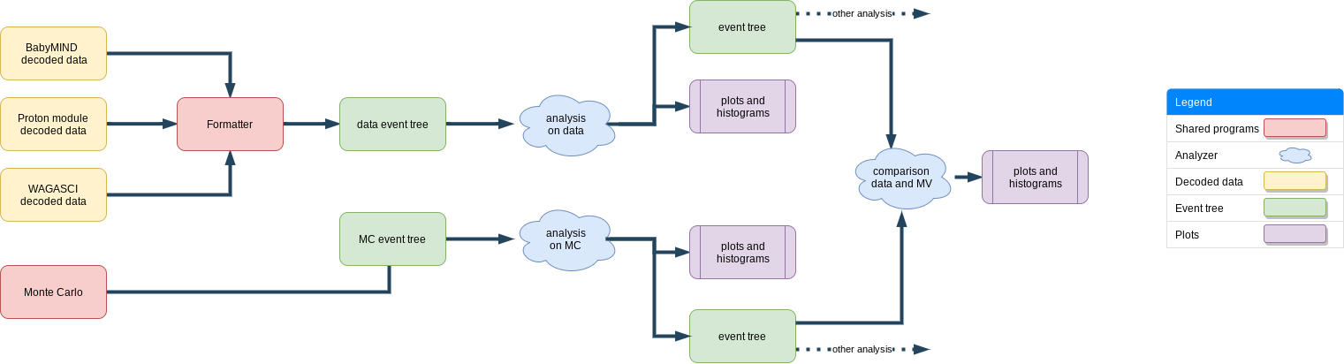
New data format
It contains all the info about hits, vertices, cluster of hits, tracks, beam
It can be used for any kind of analysis in WAGASCI-BabyMIND
It comes with a library that makes it easy to access and modify
It tries to reduce the amount of redundacy
This is in the same format

Slide 13
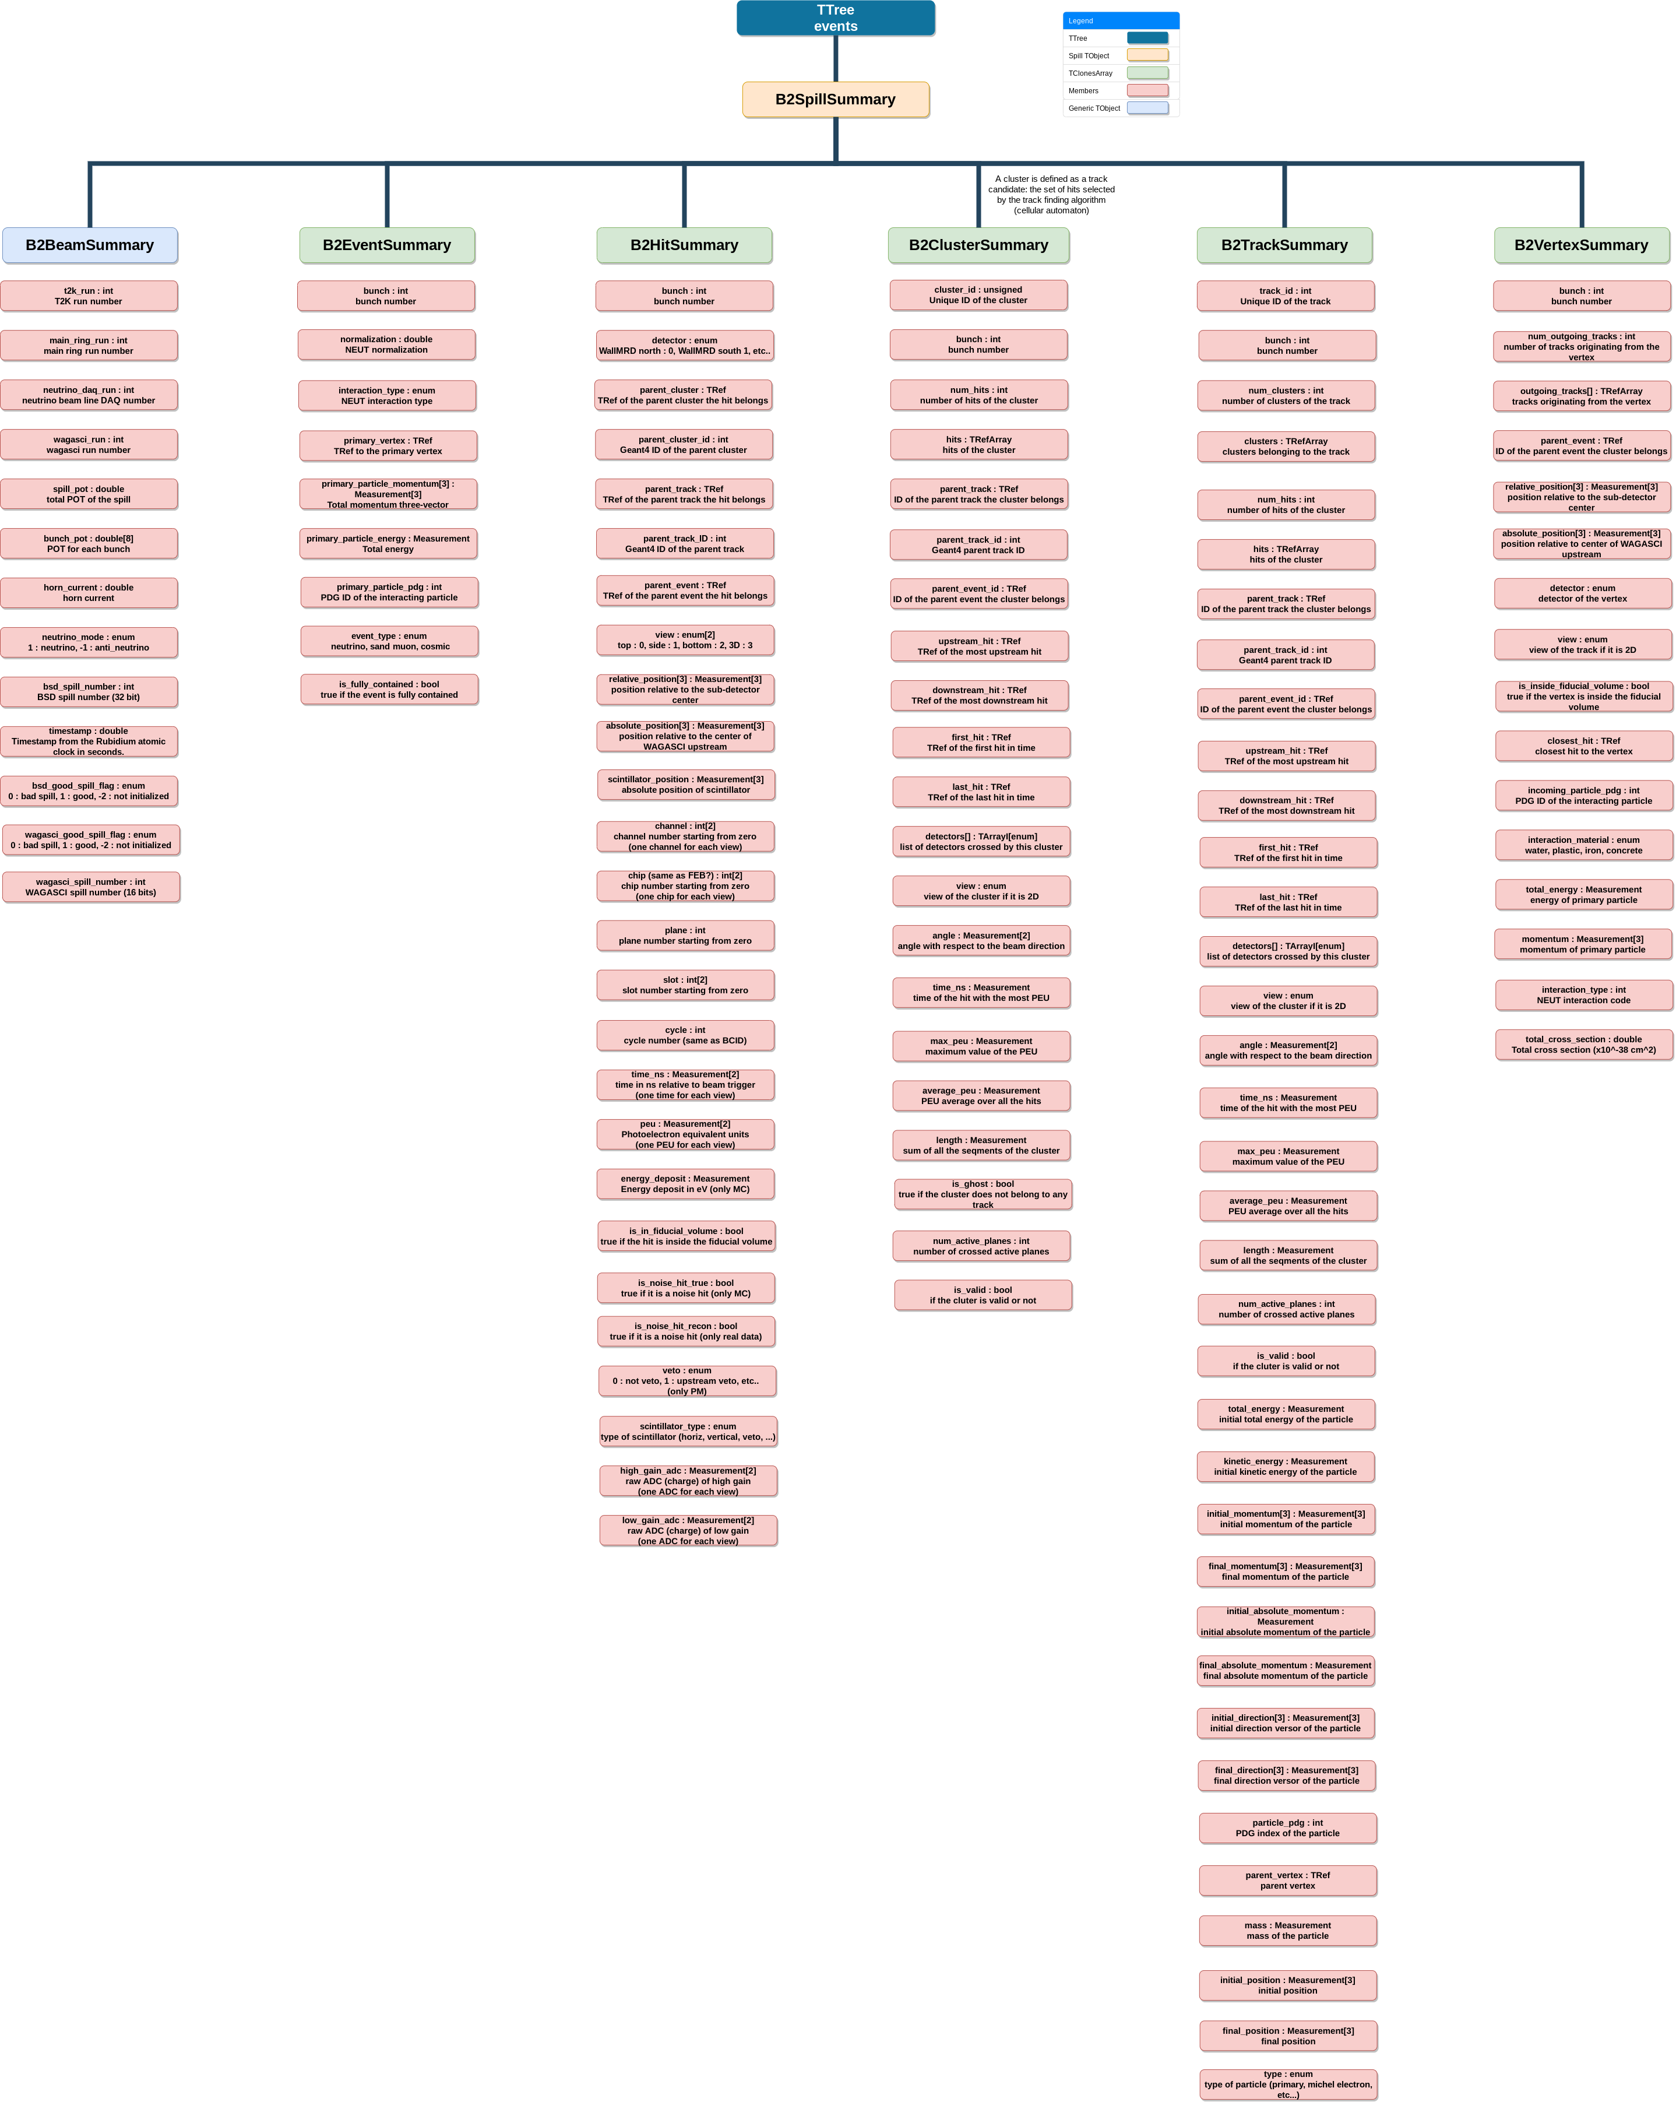
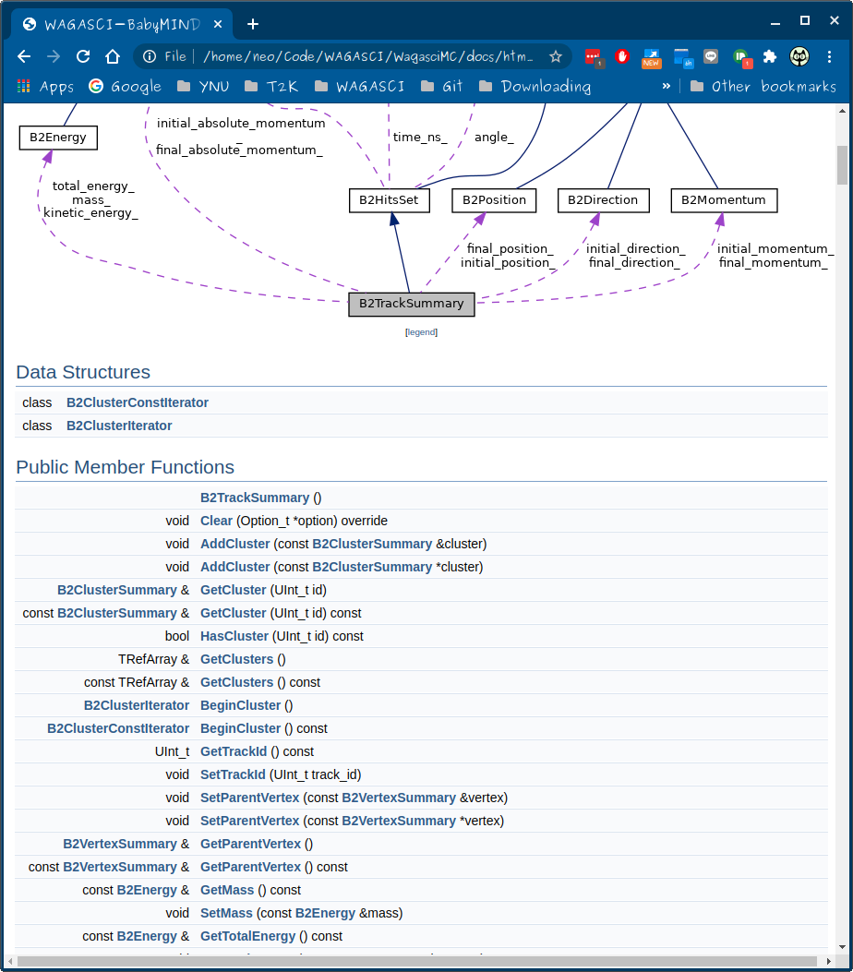
New data format
doxygen documentation

Slide 14
New configuration file
# General
gui=false
command=
neutrino-interaction-settings=WagasciDownstream
water-settings=WgupInWgdownIn
neutrino-flavor-settings=MuonNeutrino
magnetic-field=true
# IO
output-file-path=data/output.root
input-file-path=data/input.root
# GEOMETRY
geometry-dir-path=data/geometry
# Log
debug-level=info
log-file-path=data/log/B2MC.log
Every option can be configured both in the configuration file and CLI
The CLI has priority over the configuration file
A default configuration file is created the first time the program is run

Slide 15
Backup slides

